Slide 1
Strengthening Privacy in Federated Learning via Key-Switchable Homomorphic Encryption
Presented by
Mohamad Ibrahim
Supervised by
Dr. Khalil Haris
Dr. Chantal Hajjar

Slide 2
Content
Homomorphic encryption (HE): overview
Federated Learning (FL): overview and setup
Encrypted Model Aggregation Workflow
HE importance in FL
Compliance with laws and standards
Security Risks and their solution designs
xMK CKKS: overview, setup, network and problematic
DF-KS: setup, network and issues
Conclusion: summary and future works

Slide 3
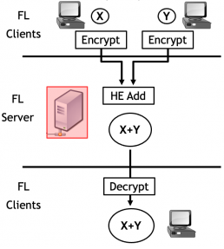
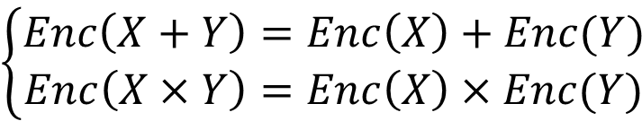
1. HE overview
HE is a form of encryption that permits computation over encrypted data
$$\left\{\begin{aligned}Enc\left(X+Y\right)=Enc\left(X\right)+Enc(Y) \\ Enc\left(X×Y\right)=Enc\left(X\right)×Enc(Y)\end{aligned}\right.$$
This type of encryption usually requires all ciphertexts from all clients to use the same key.

Slide 4
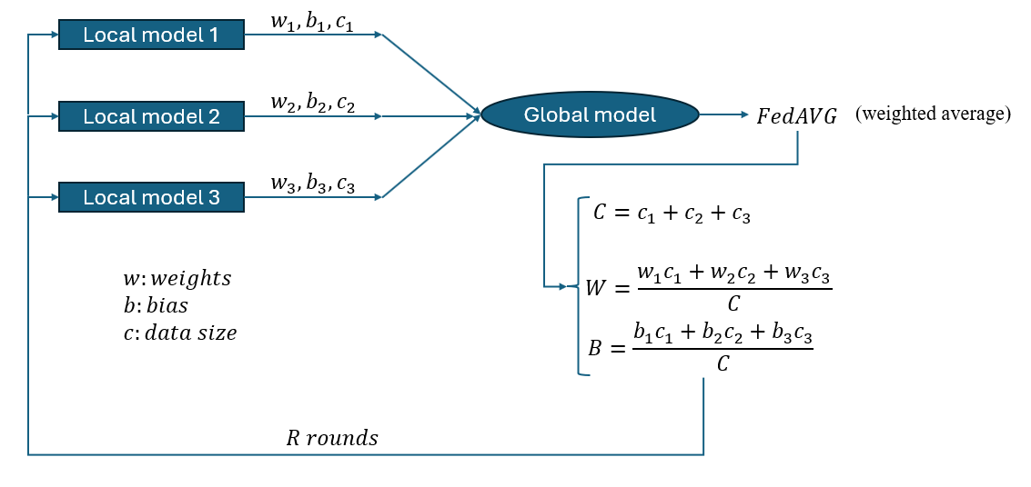
2. FL overview
FL is a process where client devices train models locally while a server performs aggregation of their updates.

Slide 5
2. FL Setup
Setup
Dataset | PIMA Indian diabetes
Size of data | 900 samples (8 features)
Server model | FedAVG
Local Model | Logistic regression with 10 epoch/client
Rounds | 10
Data split | 40% (client 1), 40% (client 2), 20% (testing data)
Planned improvements | Larger dataset with Neural Network model

Slide 6
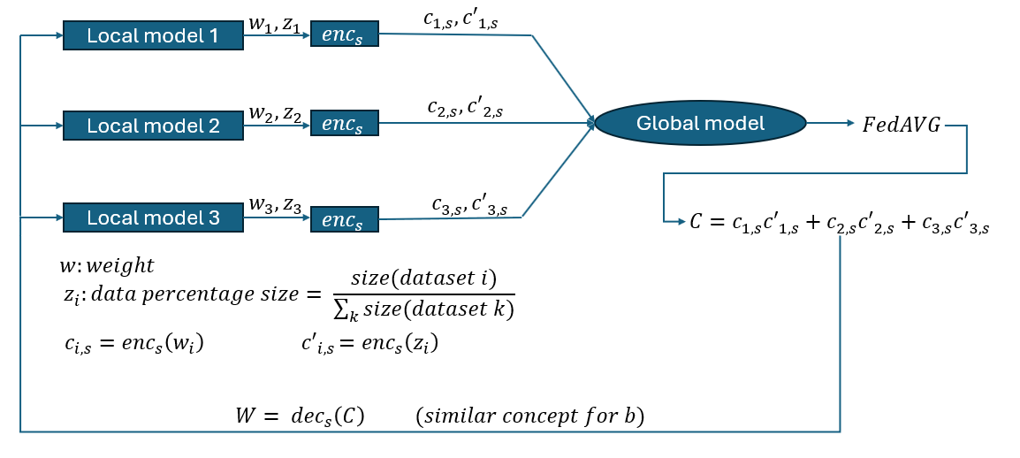
3. Encrypted Model Aggregation Workflow

Slide 7
4. HE importance in FL
Stage | Importance of HE
Local training | Allows local training on plaintext data with no need of encryption
Server aggregation | Ensure computation on ciphertext and prevent access to local data
Parameters | Prevent leakage of sensitive data
Security and privacy | Protect against membership inference, and curious server attacks

Slide 8
5. Compliance with laws and standards
GDPR: European law stands for General Data Protection Regulation
Article number | Statement
9 | Defines special categories data and prohibit processing them
32 | Mandates protection for all personal data including special categories
44 | Prohibit the transfer of data outside unless the protection is ensured
Article number | Statement
9 | Defines special categories data and prohibit processing them
32 | Mandates protection for all personal data including special categories
44 | Prohibit the transfer of data outside unless the protection is ensured
Special category → healthcare dataset
Protect data →weight and bias/gradient generated by the model
Transfer →FL
Protection → HE
NIST SP 800-57 provides the key-management requirements that ensure cryptographic protection when using HE in FL systems.

Slide 9
6. Security Risks
Using the same key across all clients poses security risks
Risk | Description
Honest-but-curious clients | Client will follow the protocol correctly but will exploit opportunities to access private data, leading to privacy leakage
Key compromise issue | All clients share one decryption key; compromising a single device reveals this key. This means one breach compromise the entire FL network

Slide 10
6. Security risks (Solutions design)
Solution design
Proposed solution
xMK CKKS
DF-KS
Based on an asymmetric encryption
Based on a symmetric encryption
Have homomorphic properties
Solve the mentioned security risks
Suitable for the FL network

Slide 11
7. xMK CKKS (overview)
Published in 2017
xMK CKKS
Asymmetric encryption
Modification of the CKKS scheme
Latice-based HE (based on RLWE)
Supports approximate computation
Suitable for FL applications

Slide 12
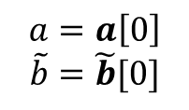
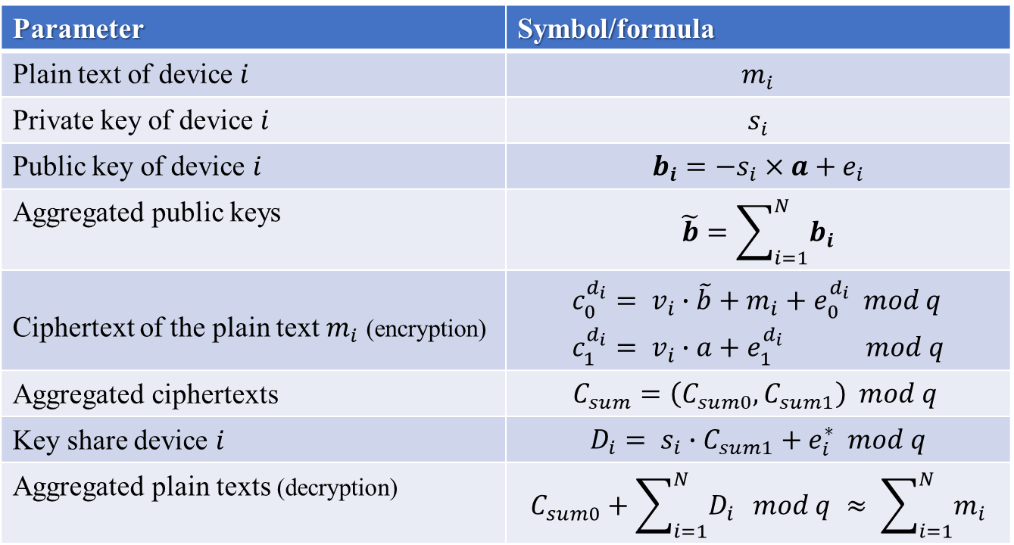
7. xMK CKKS (setup)
Parameter | Symbol/formula
Plain text of device $i$ | $$m_{i}$$
Private key of device $i$ | $$s_{i}$$
Public key of device $i$ | $$b_{i}=−s_{i}×a+e_{i}$$
Aggregated public keys | $$\tilde{b}=\sum_{i=1}^{N}{b_{i}}$$
Ciphertext of the plain text $m_{i}$ (encryption) | $$\begin{aligned}&c_{0}^{d_{i}}= v_{i}∙\tilde{b}+m_{i}+e_{0}^{d_{i}} mod q \\ &c_{1}^{d_{i}}= v_{i}∙a+e_{1}^{d_{i}} mod q\end{aligned}$$
Aggregated ciphertexts | $$C_{sum}=\left(C_{sum0},C_{sum1}\right) mod q$$
Key share device $i$ | $$D_{i}= s_{i}∙C_{sum1}+e_{i}^{∗} mod q$$
Aggregated plain texts (decryption) | $$C_{sum0}+\sum_{i=1}^{N}{D_{i}} mod q ≈ \sum_{i=1}^{N}{m_{i}}$$
$$a=a\left[0\right]$$
$$\tilde{b}=\tilde{b}[0]$$
Homomorphic
property

Slide 13





7. xMK CKKS (public keys aggregation)
Client 1
$$w_{1}$$
$$b_{1}$$
Server
$$\tilde{b}=b_{1}+b_{2}$$
$$w_{2}$$
Aggregated public keys
Client 2
$$b_{2}$$

Slide 14



7. xMK CKKS (collaborative decryption)
Client 1
$$D_{1}$$
Server
$$D=D_{1}+D_{2}$$
Client 2
$$D_{2}$$
All key Shares from all clients are required for decryption which solve the mentioned security risks. However, the decryption becomes impossible if one key share is missing.

Slide 15





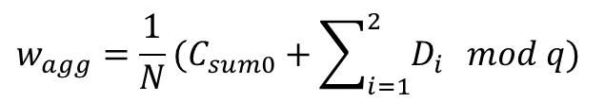




8. xMK CKKS (network)
$$ct_{1}={(c}_{0}^{d_{1}},c_{1}^{d_{1}})$$
Client 1
$$w_{1}$$
$$\tilde{b}$$
$$(ct_{1},D_{1})$$
Server
$$C_{sum}=ct_{1}+ct_{2}$$
$$ct_{2}={(c}_{0}^{d_{2}},c_{1}^{d_{2}})$$
Client 2
$$w_{2}$$
$$\tilde{b}$$
$$(ct_{2},D_{2})$$
$$w_{agg}=\frac{1}{N}(C_{sum0}+\sum_{i=1}^{2}{D_{i}} mod q)$$
Decryption is done only on server side; clients can’t decrypt the aggregated message independently.

Slide 16
7. xMK CKKS (problematics)
Decryption happens on server side
The objective is of this research is to solve this issues.
xMK CKKS
All clients required for decryption

Slide 17
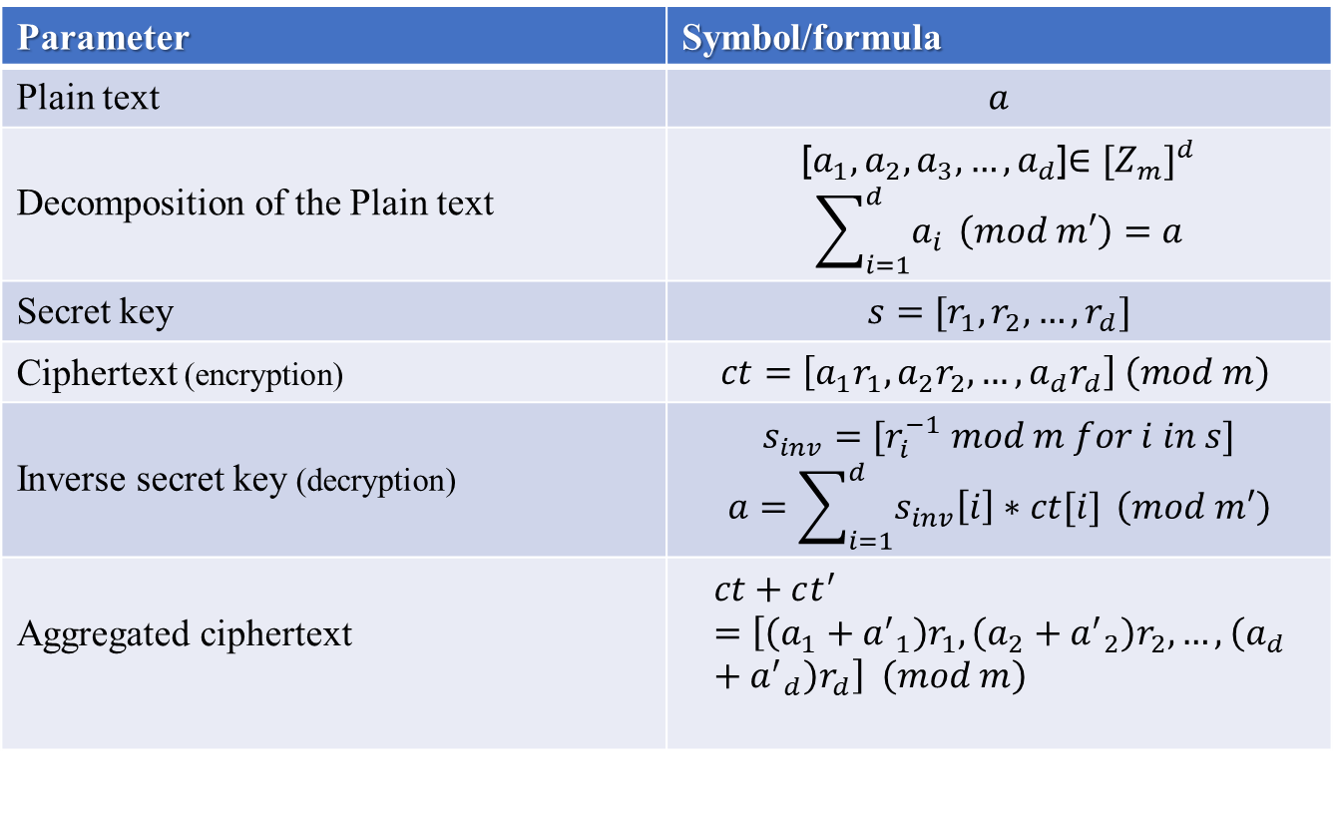
8. DF-KS scheme (DF)
Parameter | Symbol/formula
Plain text | $$a$$
Decomposition of the Plain text | [$a_{1}, a_{2},a_{3},…,a_{d}$]$∈{[Z_{m}]}^{d}$ $$\sum_{i=1}^{d}{a_{i}} \left(mod m′\right)=a$$
Secret key | $s=[r_{1},r_{2},…,r_{d}]$
Ciphertext (encryption) | $$ct=\left[a_{1}r_{1}, a_{2}r_{2},…,a_{d}r_{d}\right] \left(mod m\right)$$
Inverse secret key (decryption) | $$s_{inv}=[r_{i}^{−1} mod m for i in s]$$ $$a=\sum_{i=1}^{d}{s_{inv}\left[i\right]∗ct[i]} \left(mod m′\right)$$
Aggregated ciphertext | $$ct+ct^{′}=\left[\left(a_{1}+{a^{′}}_{1}\right)r_{1}, \left(a_{2}+{a^{′}}_{2}\right)r_{2},…, \left(a_{d}+{a^{′}}_{d}\right)r_{d}\right] \left(mod m\right)$$
Homomorphic
property

Slide 18




8. DF-KS scheme (KS)
KS is a technique that transforms data encrypted under one key into an equivalent ciphertext under another key without decrypting it.
$${dec}_{s^{∗}}\left(c^{∗}\right)={dec}_{s′}\left(c′\right)$$
$$c^{′}=Mc^{∗}$$
$$M=\left(\begin{matrix}b \\ A\end{matrix}\right)$$
$$b= −t^{′}A+m^{′}e+s_{inverse}^{∗}$$
New cipher text
old cipher text
Public matrix

Slide 19





















8. DF-KS scheme (network)
$$C_{S_{1}}$$
$$w_{agg}$$
$$w_{1}$$
$$ct_{S_{1}}$$
$${{KS}_{M_{1}^{−1}}}_{ }$$
$$D{F_{S}}_{1}$$
Client 1
$$D{F_{S}}_{1}$$
$$KS_{M_{1}}$$
$$ct_{S}$$
$$×\frac{1}{N}$$
Server
$$C_{s}=ct_{S}+c{t′}_{S}$$
$$C_{S_{2}}$$
$$w_{agg}$$
$$w_{2}$$
$$c{t′}_{S_{2}}$$
$$D{F_{S}}_{2}$$
Client 2
$$D{F_{S}}_{2}$$
$$c{t′}_{S}$$
$${{KS}_{M_{2}^{−1}}}_{ }$$
$$KS_{M_{2}}$$
$$×\frac{1}{N}$$
Compromising one key won’t affect the whole network
If one client is missing, the network continue to work normally

Slide 20
8. DF-KS scheme (issue)

Slide 21
9. Conclusion (summary)
Scheme | Limitation | Advantage
xMK CKKS | .Decryption on server side only .Decryption is not possible if one client is missing | .Immune to plaintext/ciphertext couple attack
DF-KS | .Vulnerable to plaintext/ciphertext couple attack | .Decryption happens on client side .If one client goes missing decryption remains possible

Slide 22
9. Conclusion (Future works)
Instead of logistic regression with PIMA dataset
Use larger dataset with a neural network model
Instead of DF-KS scheme
Study and implement CKKS with KS scheme

Slide 23
Thank you
QA

